Slide 1
South Carolina Communities that Care (CTC) Survey
South Carolina Department of Alcohol and Other Drug Abuse Services

Slide 2
Objectives
South Carolina Department of Alcohol and Other Drug Abuse Services
Background
Students Surveyed 2022
Survey Contents & Data Confidentiality
Overview of Survey
Contact Information

Slide 3
CTC Survey Background
South Carolina Department of Alcohol and Other Drug Abuse Services
The CTC survey is a comprehensive anonymous survey that assesses youth/adolescent substance use-related behaviors, access and perceptions
In 2022, 26 out of 46 counties implemented the survey.
Survey is voluntary, anonymous and self-administered.
Takes an average of 15 – 20 minutes to complete the survey.

Slide 4
CTC Survey Background
South Carolina Department of Alcohol and Other Drug Abuse Services
Survey should be done online
A county can make a written request to DAODAS for pen/paper
Parents must give consent for child participation (opt-out form option is recommended).
Student confidentiality will be strictly protected.
Impact on school will be minimal to participate and the benefits to the school and county may be far-reaching.
CTC Survey should help identify county’s greatest substance related issues.
Programs and policies can be implemented that will prevent or decrease substance misuse.

Slide 5
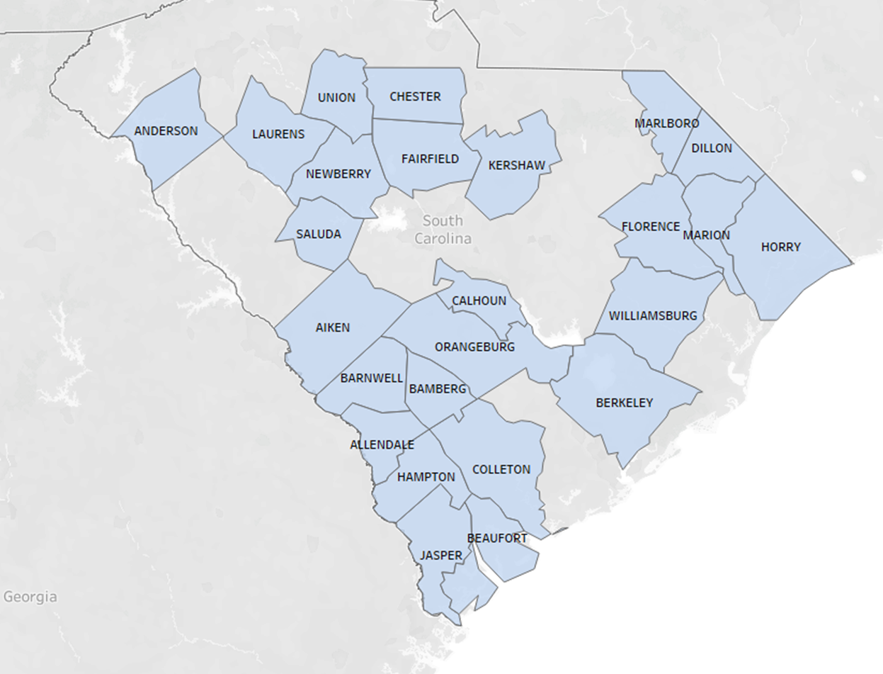
Students Surveyed 2022
South Carolina Department of Alcohol and Other Drug Abuse Services

Slide 6
CTC Survey Contents & Data Confidentiality
South Carolina Department of Alcohol and Other Drug Abuse Services
The focus of the survey content is on behaviors that can result in injury and/or impede positive development among the youth.
89 item survey with topics ranging from:
Demographics
Current and lifetime use of various substances such as: tobacco, alcohol, marijuana along with other drugs
Access/sources of substances
Perceived peer and parental attitudes/risk perceptions/disapproval of use
Risk behaviors
Notes:
Mention comment how currently we are reviewing questions so we are taking all feedback on questions at this time

Slide 7
CTC Survey Access & Use of Data
South Carolina Department of Alcohol and Other Drug Abuse Services
Who will have access to what type of data:
Each school will have access to their respective data on request.
County Drug Authority will also have access to local survey results.
DAODAS will have access to all collected data for the purpose of state level analyses and generate county reports (without any identifiers).
Results can be used for a variety of purposes:
Future academic and extracurricular planning
Policy agenda structuring (e.g., school district policies)
Grant writing to introduce new policies, programs and solutions to help students improve their health

Slide 8
South Carolina Department of Alcohol and Other Drug Abuse Services
Overview of CTC Survey
SC CTC Survey administration dates are January 22 – March 25, 2024.
Schools will have the opportunity to add up to four locally determined questions to their survey.
Additional questions must be submitted to DAODAS by November 17, 2023
Training and technical assistance will be available.
DAODAS will be the sole fiscal agent of the 2024 SC CTC Survey, and will issue payment to the survey vendor for survey administration.

Slide 9
South Carolina Department of Alcohol and Other Drug Abuse Services
Overview of CTC Survey
The number of schools that are recommended to participate depends on the size of the district. School districts with:
1-3 schools must administer the survey in at least 1 school.
4-6 must administer the survey in at least 3.
7-9 must administer the survey in at least 5.
10-12 must administer the survey in at least 6.
more than 12 HS must administer the survey in at least 8.

Slide 10
South Carolina Department of Alcohol and Other Drug Abuse Services
CTC Survey Administration & Plan
Simplest Approach - Survey entire middle and high school student body.
Otherwise, recommendation is to survey at least 7th, 9th and 11th grade students.
Sites are encouraged to go beyond their 2022 sampling plan (those who conducted CTC previously) to include more schools and grades when possible.
At minimum, surveying the same schools and grades that they did in 2022 would ensure stronger data comparisons.

Slide 11
South Carolina Department of Alcohol and Other Drug Abuse Services
CTC Survey Activities
District
Determine the type of consent procedures and ensure parental consent is addressed.
Schools
Identify a contact person to work with local drug authority.
Administer the survey as per the instructions.
Classroom Teachers
Read a written statement about the survey and review the classroom survey instructions.
Ensure that students whose parents refused consent do not participate in the study.

Slide 12
South Carolina Department of Alcohol and Other Drug Abuse Services
Analytic Plan
DAODAS is not planning to utilize an outside vendor to administer surveys
To mitigate previous year technical challenges, DAODAS will maintain data collection and storage in-house
Prior to online administration, response forms will go through a quality control review to test the survey product regarding data processing and management
Throughout administration, questions concerning number of responses, school participation, progress towards target sample etc. may be directed to DAODAS Epidemiologist
Reports automatically shared to county providers
State report (grades 7, 9, 11)
County level report
Reports shared by request
School district level
Assistance with cross-tab results
Cleaned data*
Recoded by response type and potential identifiers removed
Notes:
REDCap which is an online data collection tool supported on both computer and mobile devices. It is frequently used in clinical research and is a secure data collection tool, meeting HIPAA compliance standards
Once completed respondents will not be able to go back and change the form

Slide 13
Timeline
South Carolina Department of Alcohol and Other Drug Abuse Services
June 30, 2023
Wave 1: Survey recruitment at local level-confirm participation with DAODAS
June 16- August 3, 2023
DAODAS provides County Alcohol and Drug prevention staff the new draft survey to review with school officials. Feedback to DAODAS by August 3
October 31, 2023
Wave 2: Survey recruitment at local level-confirm participation with DAODAS
November 17, 2023
December 4-8, 2023
Additional questions to be added to school-specific surveys
Initial Survey administration instructional training

Slide 14
Timeline
South Carolina Department of Alcohol and Other Drug Abuse Services
January 8-12, 2024
Final/follow-up survey administration instructional training
January 12, 2024
All survey administration instructions e-mailed to named contact in each county.
January 22-March 15, 2024
Survey administered to students.
April-May 2024
May 2, 2024
Quality Control and analytic period
Highlights from State report provided at May Prevention Quarterly Meeting

Slide 15
South Carolina Department of Alcohol and Other Drug Abuse Services
Contact Information
Who to contact for more information
Michelle Nienhius, Prevention Division Director at mnienhius@daodas.sc.gov
Emma Zawacki, Epidemiologist
ezawacki@daodas.sc.gov

Slide 16
South Carolina Department of Alcohol and Other Drug Abuse Services

